Slide 1
Collaborative Improvement: A Brief and Recent History
Healthcare Learning Collaboratives:
Lessons Learned and Future Opportunities
Baltimore, MD: November 4 , 2015
November 4, 2015
Donald M. Berwick, MD
President Emeritus and Senior Fellow
Institute for Healthcare Improvement

Slide 2
Model I: Bad Apples
Frequency
The
Problem
Quality

Slide 3
Model I: Bad Apples
“Reliance on Inspection
to Improve”
Frequency
The
Problem
Quality

Slide 4
The Cycle of Fear
Increase
Fear
Kill the
Messenger
Micromanage
Filter the
Information

Slide 5
Some Consequences of Reliance on Inspection
Measurement Gone Wild – Adds massive costs; Distracts from what matters; Objectifies the crucial subjective
Accountability – Chills dialogue and authentic exchange; Loses upward information flow
“Skin in the Game” – Afflicts the disadvantaged; Lacks any evidence base
Standardization – Chills innovation; Disconnects care from individual patients
Markets – Drives oversupply; Chills exchange

Slide 6
“The First Law of Improvement”
Every system is perfectly designed to achieve exactly the results it gets.
Paul Batalden, MD

Slide 7
“Some heades haue taken two head is better then one:
But ten heads without wit, I wene as good none.”
- John Heywood, 1546 AD

Slide 8

Paul Batalden, MD

Slide 9
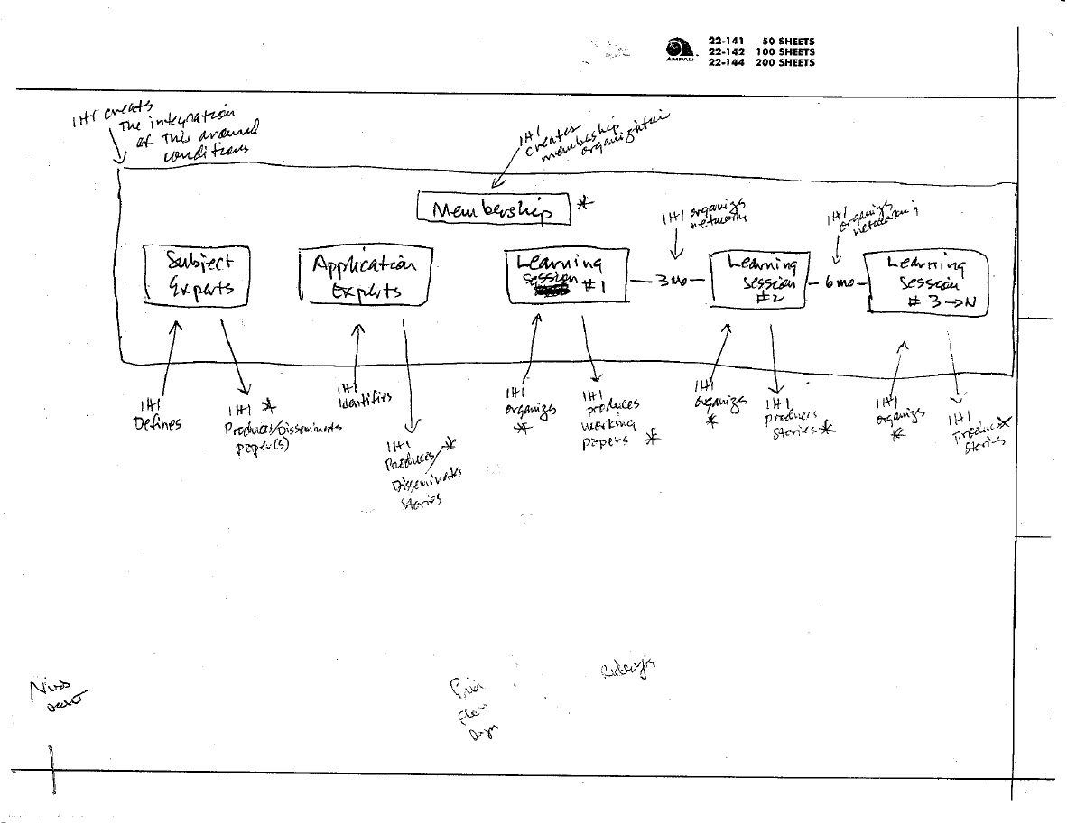

Slide 10
“IHI organizes
activities”…
“produces
stories”
“IHI creates the
interpretation of this
around conditions”
“IHI creates
membership
Organization”
“Pain…
Flow…
Drugs”

Slide 11
Breakthrough Series Collaborative
Pick a topic for improvement
Engage a panel of experts
Harvest “change concepts”
Invite care organizations to enroll teams
Launch a series of learning sessions
Use the learning sessions to teach improvement
Summarize

Slide 12
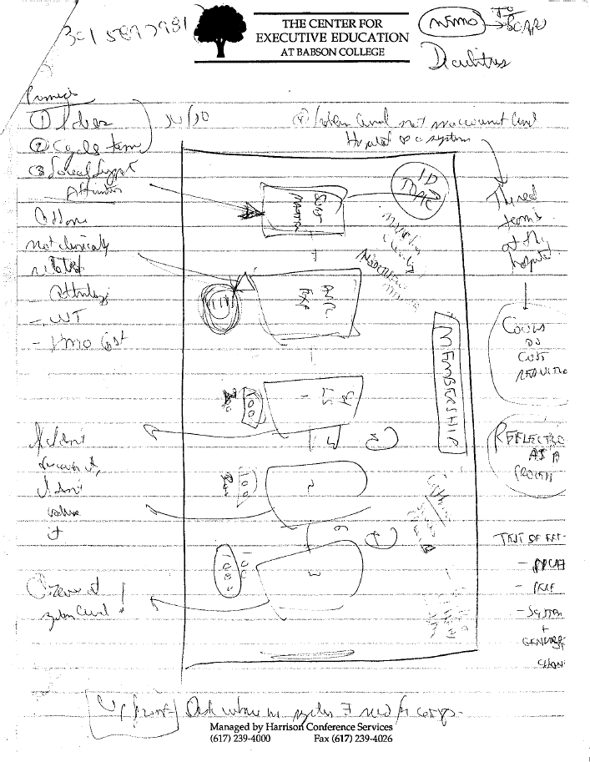

Slide 13
“Memo to the
Board”
“Tom Nolan’s
phone number”
“4. Problem level, not
macrounit level. Hospital
as a system”
1. Ideas
2. Cycle Times
3. Social Support
– Affirmation
“50/50”
“The real team is at
the hospital”
“Could do cost
reduction”
“If I don’t discover it,
I don’t value it”
“Reflection as
a process”
“Observe at
system level”
“Up front: Ask where
in the system there
is a need for
improvement”

Slide 14

Tom Nolan, PhD

Slide 16
Criteria for Selection
Clinical importance to patients
Financial importance to organizations
Experts have achieved better performance
Choose cycle times and scale that permitted noticeable improvement within weeks or months
Seek out best practice sites and great ideas for change.

Slide 17
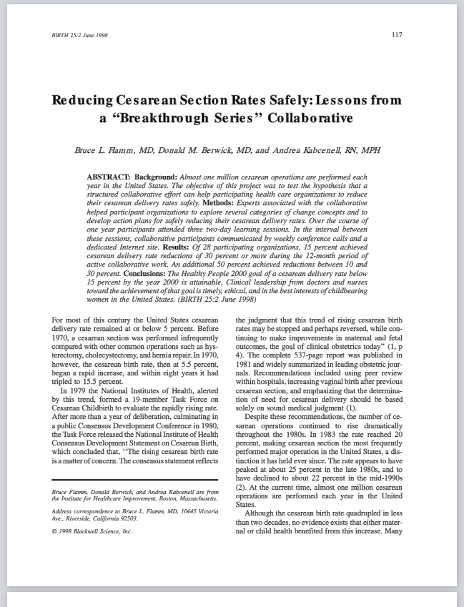

Slide 18
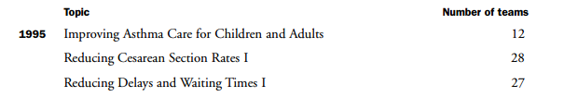

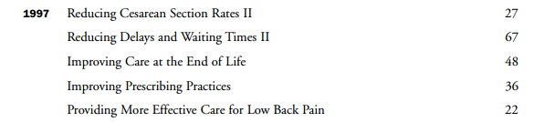
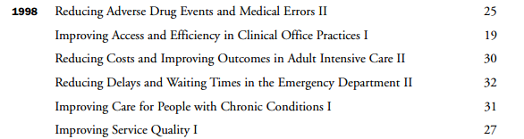

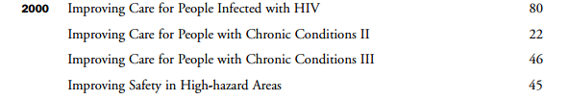

52 Breakthrough Series Collaboratives

Slide 19

Dr. Ken Kizer, Veterans Health Administration

Slide 20
Vertically Integrated Service Networks (VISNs)
22 VISNs; total of 134 VA centers
8-Month Results:
Median wait times fell from 48 to 22 days
54% reduction in wait time
3-Year Results:
Wait times fell from >60.4 days to 28.4 days
VISN 2 achieved wait times of 16 days

Slide 21


Slide 22

Dr. John Oldham
National Primary Care Development
Team (PCDT)
Development Team (NPDT) focus:
  Access to primary care
  Care for patients with proven coronary heart disease
  Access to routine secondary care services.
11 regional PCDT organizations
1000 practices in the UK covered 7 million patients
Reduced waiting times for >32 million patients
The largest improvement program in the world, 2002

Slide 26
Learning over Time:
“Plan-Do-Study-Act” Cycles
in a Large System
Wave 2
Wave 3
Wave 1

Slide 27



Early Care Improvement Collaboratives

Slide 28
Pressure Ulcer Prevention
Facility Acquired Pressure Ulcer Rate
St. Vincent Hospital, Jacksonville
Alpha Spread Ascension Health System
50 hospitals reporting: Overall Rate 1.38
Zero!

Slide 29
Error Reduction at Ascension
Preventable Error
Reduction in rate
Pressure Ulcer
95%
Neonatal Mortality
79%
Birth Trauma
74%
Ventilator-Acquired Pneumonia
56%
Falls with Serious Injury
54%
Bloodstream Infections
32%

Slide 30
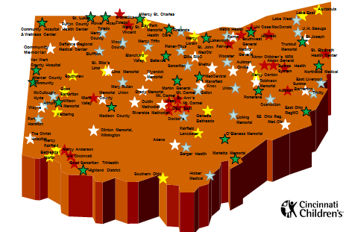
OPQC = Population Health
Ohio Perinatal Quality Collaborative
39 Weeks & Birth Registry Accuracy
105 (of 107)
Maternity Hospitals
NAS
52 (of 54)
Level II and III NICUs
Progesterone
Pilot: 23 OB Clinics
Spread: +15-20 OB Clinics
NICU Grads
Pilot: 3 NICUs
Spread: +3 NICUs

Slide 31
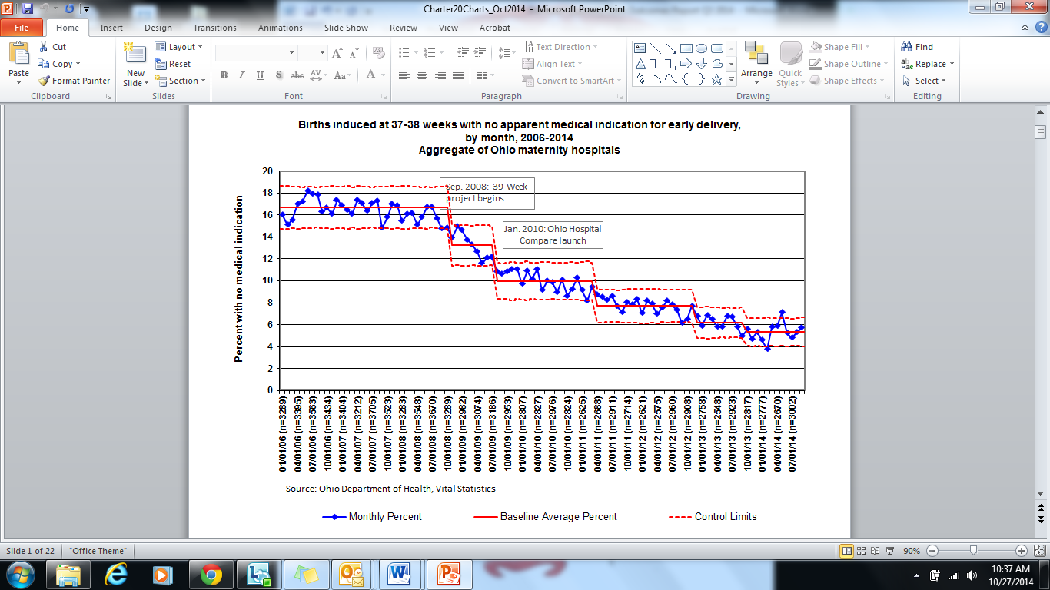
Decreasing Non-Medically Indicated
Scheduled Deliveries Prior to 39 Weeks Gestation

Slide 32
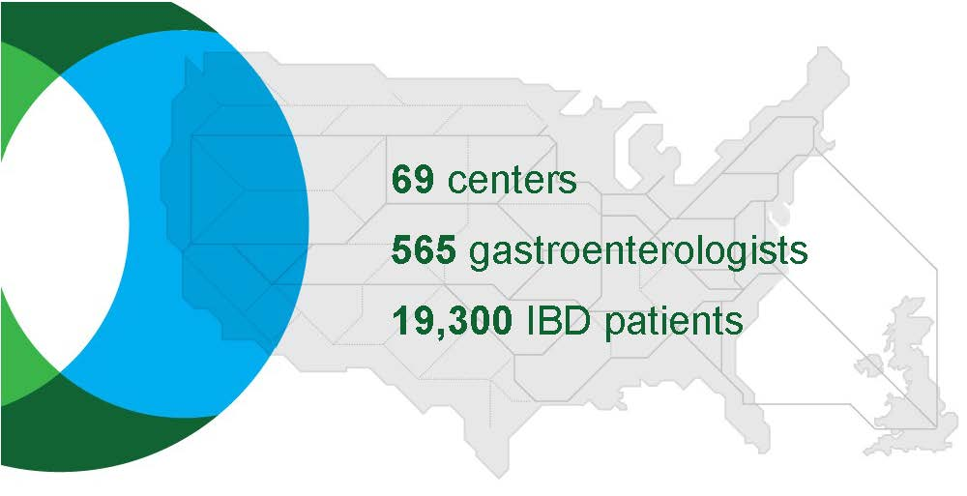
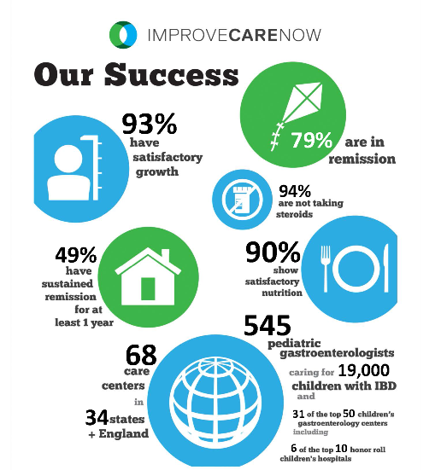
ImproveCareNow Network
Funded Research
Industry sponsored research studies – Adalimumab Concomitant Therapy
Methotraxate Trial
PCORI PPRN Phase 1 & 2
Research objectives elicitation & prioritization (CHOP)
PRO collection – PROMIS study
PPRN demo PFA

Slide 33
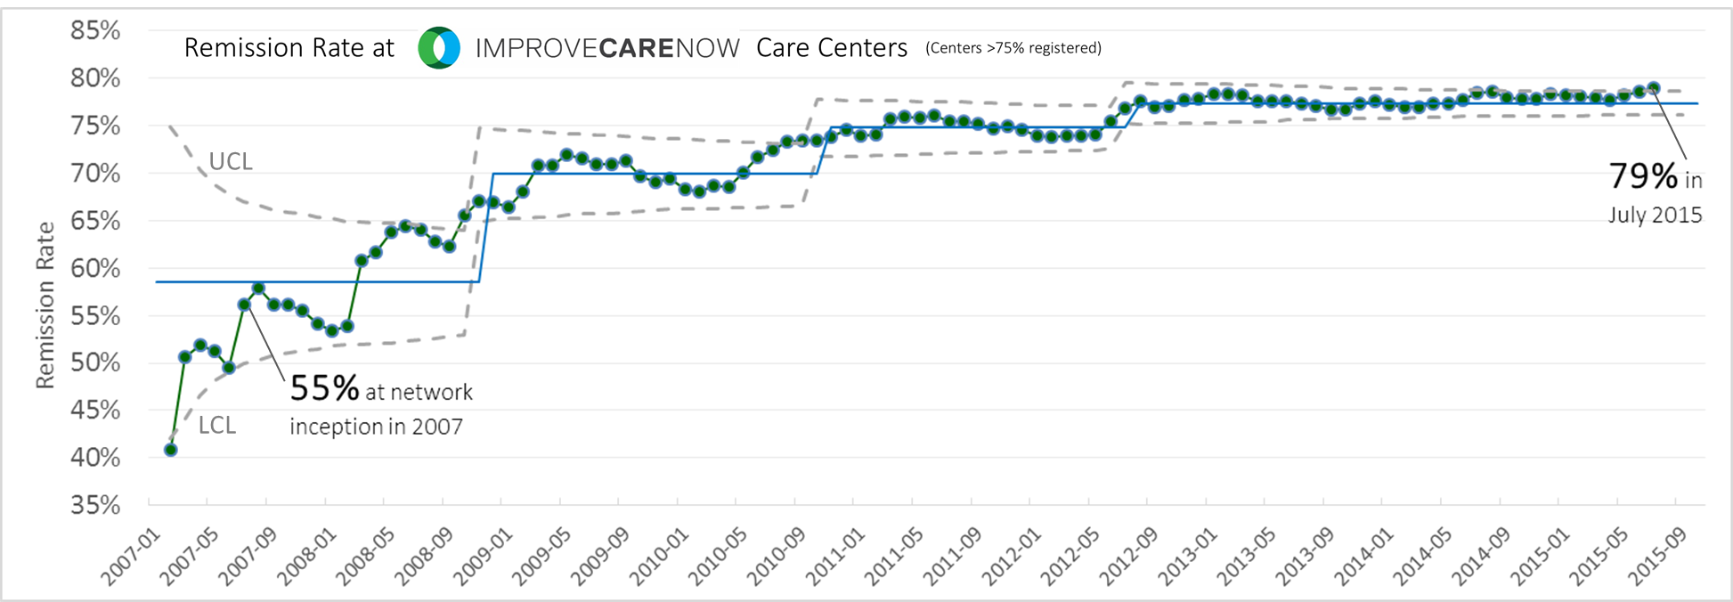
Inflammatory Bowel Disease Remission Rates:
“Improve Care Now” Care Centers

Slide 34


Slide 35






Patient Safety Collaboratives: Today

Slide 36

Modifications for Resource-Poor Settings
Coaches
Regional meetings
Cell phone technologies
Overcome geographic, financial constraints
Photo: FreeDigitalPhotos.net

Slide 37

“The Breakthrough Series (BTS) structure has proven highly applicable to efforts to improve performance of the more centrally directed, district-based health systems in Africa.
Lack of Internet connectivity necessitated reliance on change agents who pollinated change ideas across sites in the network…
…[the BTS] became a learning system used primarily for innovation of changes that could then be spread.
The BTS was also used as a spread mechanism for IHI’s Ghana project on maternal and neonatal mortality…In South Africa, the BTS model was used for innovating and demonstrating effective implementation of HIV care at a District level, and developing change packages that were then spread throughout the national health care system…
- Pierre Barker, 2015

Slide 38
Paul Batalden’s Sketch

Slide 39
Breakthrough Series Skeptics
Doubts about scientific discipline of measurement, inference, results reporting
Doubts about data
Doubts about attribution
Doubts about sustainability: Do these results last?

Slide 40

Lingering Questions
“Do improvement collaboratives work?”
…“Does parenting work?”
…“Does schooling work?”
Photo: http://www.boas.pro/remco-boas

Slide 41

Pawson and Tilley: Realistic Evaluation
41

Slide 42
“The idea [of collaborative improvement] is better seen as a learning strategy – an action learning strategy – not as an intervention that should be evaluated as a new treatment should be.”
- Paul Batalden, 2015

Slide 43
“The bedrock value within a collaborative is freedom from fear in any form – fear of inspection, fear of failure, fear of reprisal.”
- Kedar Mate, 2015

Slide 44
“Never worry alone.”
- Institute for Healthcare Improvement

