Slide 1

“EMS” in the
New Healthcare Environment
© 2015 MedStar Mobile Healthcare

Slide 2





About MedStar…
Governmental agency (PUM) serving Ft. Worth and 14 Cities
  Self-Operated
  980,000 residents, 421 Sq. miles
  Exclusive provider - emergency and non emergency
125,000 responses annually
450 employees
$37.5 million budget
  No tax subsidy
Fully deployed system status management
Medical Control from 14 member Emergency Physician’s Advisory Board (EPAB)
  Physician Medical Directors from all emergency departments in service area + 5 Tarrant County Medical Society reps

Slide 3

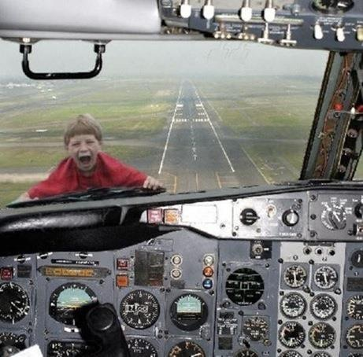
Frenetic Change

Slide 4
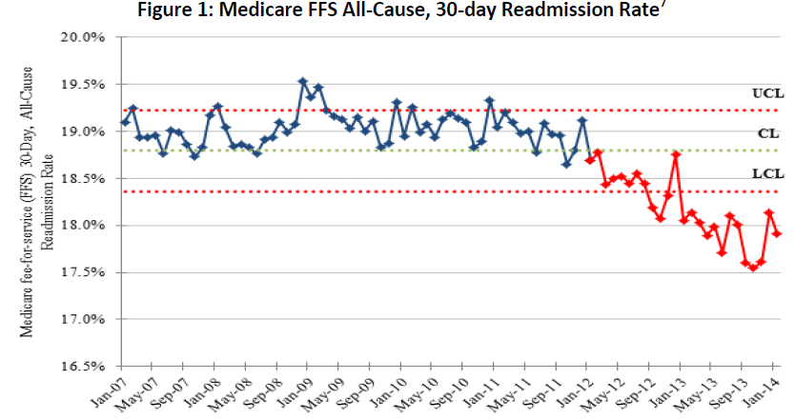
The all-cause 30-day hospital readmission rate among Medicare fee-for-service beneficiaries plummeted further to approximately 17.5 percent in 2013, translating into an estimated 150,000 fewer hospital readmissions between January 2012 and December 2013.
This represents an 8 percent reduction in the Medicare fee-for service all-cause 30-day readmissions rate.
http://innovation.cms.gov/Files/reports/patient-safety-results.pdf

Slide 5

Readmission reduction: A losing battle?
October 16, 2014
Readmissions may be "beyond a hospital's control," according to a new study published in the American Journal of Managed Care.
They gave half the patients an intervention featuring pre-discharge education and planning, post-discharge follow-up, an available hotline and "bridging" techniques such as daily symptom checks.
Linden and his coauthor, Susan W. Butterworth, Ph.D., found no statistical difference in readmissions between the two groups after both 30-day and 90-day periods, although mortality was lower in the intervention group than the control group.
http://www.ajmc.com/publications/issue/2014/2014-vol20-n10/a-comprehensive-hospital-based-intervention-to-reduce-readmissions-for-chronically-ill-patients-a-randomized-controlled-trial/3

Slide 6
The research found only a single instance where a patient received same-day care from a PCP, and in that case the issue was dealt with without requiring emergency care. Linden and Butterworth cited several cases in which patients sought an appointment with their PCPs for non-emergency conditions but were sent to the emergency room or unable to make an appointment for weeks.
To enhance the innovative nature of the intervention, 2 post discharge components were added—motivational interviewing–based health coaching (MI) and symptom monitoring using interactive voice response (IVR). MI is a standardized, evidence-based health coaching approach described as a “collaborative, goal-oriented style of communication with particular attention to the language of change.”
Although the Transitional Care Model sometimes includes home visits, we did not include this in the intervention due to funding constraints and the lack of evidence that it is a compelling component.

Slide 7

Take-Away Points from the Research:
Our results suggest the need to continue experimenting with new interventions targeting readmissions, especially for severely ill patients.
Our addition of interactive voice response and motivational interviewing–based health coaching to the transitional care model did not improve outcomes.
Our findings suggest that correcting improper use of the inhaler and increasing adherence to inhaled medications may reduce 90-day mortality for chronic obstructive pulmonary disease patients.
Hospitals, without collaborative relationships with community-based providers, may have limited ability to reduce readmissions, as they cannot ensure timely and continuous care for patients after discharge.
A challenging road lies ahead for stand-alone community hospitals seeking to decrease readmissions and avoid financial penalties.

Slide 8

How house calls can cut down on hospital readmissions
The Valley Hospital in New Jersey sends medical teams to patients' homes to coordinate follow-up care
By Leslie Small
April 23, 2015
The healthcare industry abounds with new ideas to reduce unplanned hospital readmissions and emergency department (ED) visits, but a New Jersey hospital has turned to a seemingly old-fashioned medical strategy--the house call.
The Valley Hospital in Ridgewood, New Jersey, launched its Mobile Integrated Healthcare Program in August 2014 to provide "proactive, post-discharge home check-ups" to patients with cardiopulmonary disease who are at high risk for readmission and either declined or didn't qualify for home care services, according to a statement from the hospital.
In the program, a team composed of a paramedic, an emergency medical technician and a critical care nurse conducts a physical exam of the patient, offers medication education, reinforces discharge instructions, completes a safety survey of the patient's home and confirms that the patient has made a follow-up appointment with a physician.
http://www.fiercehealthcare.com/story/how-house-calls-can-cut-down-hospital-readmissions/2015-04-23

Slide 9

Hospitals' Goal: Empty Beds
08.21.15 by Bill Santamour H&HN Editor
“IF OUR BEDS ARE FILLED, IT MEANS WE’VE FAILED.”
That’s the striking message in an ad I came across for Mount Sinai Hospital, and it could speak for hospitals across the nation as they transform from being strictly providers of care to promoters of health. The ad does a good job of explaining in lay terms how the new focus on population health management means that “instead of receiving care that’s isolated and intermittent, patients receive care that’s continuous and coordinated, much of it outside the traditional hospital setting.”
It spotlights Mount Sinai’s “tremendous emphasis on wellness programs”; its Mobile Acute Care Team, which treats patients at home for certain conditions that otherwise would land them in the hospital; and its Preventable Admissions Care Team aimed at averting readmissions by providing both medical care and help with nonmedical factors that impact health and access to care, like housing and literacy.
Not a lot there that hospital leaders don’t already know, of course, but you’ve got to admit, the headline’s a grabber.
http://www.hhnmag.com/Daily/2015/August/weekly-reading-icd10-mcdonalds-xenotransplants-blog-santamour?

Slide 10

ICAHN SCHOOL OF MEDICINE AT MOUNT SINAI
Project Title: "Bundled Payment for Mobile Acute Care Team Services"
Geographic Reach: New York
Estimated Funding Amount: $9,619,517
Summary:
The Icahn School of Medicine at Mount Sinai project will test Mobile Acute Care Team (MACT) Services, which will utilize the expertise of multiple providers and services already in existence in most parts of the United States but will transform their roles to address acute care needs in an outpatient setting. MACT is based on the hospital-at-home model, which has proven successful in a variety of settings. MACT will treat patients requiring hospital admission for selected conditions at home. The core MACT team will involve physicians, nurse practitioners, registered nurses, social work, community paramedics, care coaches, physical therapy, occupational therapy and speech therapy, and home health aides. The core MACT team will provide essential ancillary services such as community-based radiology, lab services (including point of care testing), nursing services, durable medical equipment, pharmacy and infusion services, telemedicine, and interdisciplinary post-acute care services for 30 days after admission. After 30 days, the team will ensure a safe transition back to community providers and provide referrals to appropriate services.
http://innovation.cms.gov/initiatives/Participant/Health-Care-Innovation-Awards-Round-Two/Icahn-School-Of-Medicine-At-Mount-Sinai.html

Slide 11
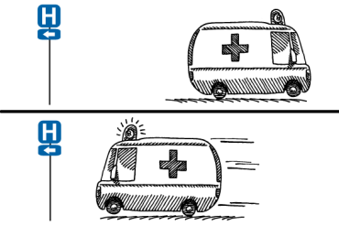
CP MEDICAL CTR-DAVIES HOSP | SAN FRAN | CA | 0.05% | 0.01% | 0.01% | 0.00%
CP MEDICAL CTR-PACIFIC HOSP | SAN FRAN | CA | 0.27% | 0.00% | 0.01% | 0.17%
CHINESE HOSPITAL | SAN FRAN | CA | 0.55% | 0.51% | 2.16% | 2.12%
KAISER FOUNDATION SAN FRAN | SAN FRAN | CA | 0.00% | 0.00% | 0.06% | 0.00%
SAINT FRANCIS MEMORIAL HOSPITAL | SAN FRAN | CA | 0.18% | 0.42% | 0.53% | 0.22%
SAN FRANCISCO GENERAL HOSPITAL | SAN FRAN | CA | 0.15% | 0.25% | 0.24% | 0.34%
ST MARY'S MEDICAL CENTER | SAN FRAN | CA | 0.15% | 0.03% | 0.16% | 0.25%
UCSF MEDICAL CENTER | SAN FRAN | CA | 0.10% | 0.02% | 0.23% | 0.34%
ST ROSE HOSPITAL | HAYWARD | CA | 0.55% | 0.58% | 1.06% | 1.23%
LODI MEMORIAL HOSPITAL | LODI | CA | 0.08% | 0.06% | 0.10% | 0.35%
EL CAMINO HOSPITAL | MOUNTAIN VIEW | CA | 0.00% | 0.00% | 0.43% | 0.75%
MILLS-PENINSULA MEDICAL CENTER | BURLINGAME | CA | 0.18% | 0.06% | 0.00% | 0.02%

Slide 12
BAYLOR ALL SAINTS | FORT WORTH | TX | 0.00% | 0.00% | 0.00% | 0.00%
BAYLOR SURGICAL HOSPITAL | FORT WORTH | TX | 0.00% | 0.00% | 2.76% | 3.00%
JPS HEALTH NETWORK | FORT WORTH | TX | 0.08% | 0.03% | 0.03% | 0.08%
PLAZA MEDICAL CENTER | FORT WORTH | TX | 0.30% | 0.12% | 0.00% | 0.00%
THR - FORT WORTH | FORT WORTH | TX | 0.59% | 0.32% | 0.19% | 0.11%
THR - ALLIANCE | FORT WORTH | TX | N/A | N/A | 0.00% | 0.08%
THR-SOUTHWEST | FORT WORTH | TX | 0.01% | 0.00% | 0.01% | 0.08%
NORTH SHORE UNIVERSITY | MANHASSET | NY | 1.00% | 0.98% | 0.55% | 0.39%
DUKE HEALTH RALEIGH HOSPITAL | RALEIGH | NC | 0.06% | 0.00% | 1.43% | 1.10%
REX HOSPITAL | RALEIGH | NC | 0.15% | 0.08% | 0.04% | 0.07%
WAKEMED, RALEIGH CAMPUS | RALEIGH | NC | 0.28% | 0.42% | 0.38% | 0.00%
RENOWN REGIONAL | RENO | NV | 0.31% | 0.10% | 0.27% | 0.02%
RENOWN SOUTH MEADOW | RENO | NV | 0.00% | 0.00% | 0.12% | 0.10%
NORTHERN NEVADA MEDICAL CENTER | SPARKS | NV | 0.04% | 0.13% | 2.11% | 1.42%

Slide 13
Emergency
Medical
Services?

Slide 14

Conundrum…
Misaligned Incentives
  Only paid to transport
  “EMS” is a transportation benefit
  NOT a medical benefit

Slide 15


Our Role?
“Emergency medical services (EMS) of the future will be community-based health management that is fully integrated with the overall health care system. It will have the ability to identify and modify illness and injury risks, provide acute illness and injury care and follow-up, and contribute to the treatment of chronic conditions and community health monitoring. This new entity will be developed from redistribution of existing health care resources and will be integrated with other health care providers and public health and public safety agencies. It will improve community health and result in more appropriate use of acute health care resources. EMS will remain the public’s emergency medical safety net.”

Slide 16
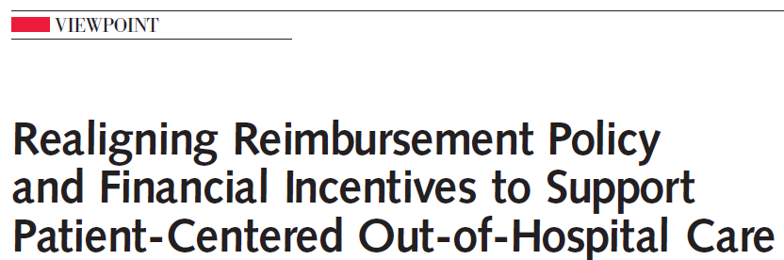

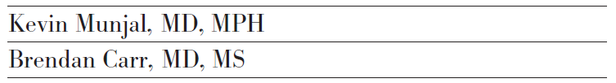


Slide 17
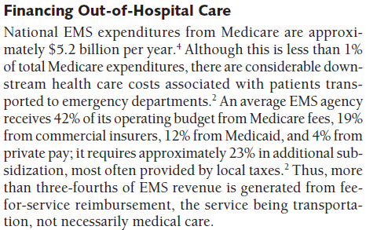

Slide 18
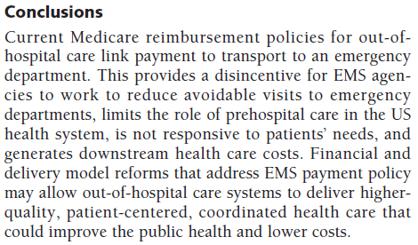

Slide 19


Mobile Integrated
Healthcare
EMS Loyalty Program
System Abusers
9-1-1 Nurse Triage
CHF/High Risk Dx Readmissions
Observational Admission Avoidance
Hospice Revocation Avoidance
Home Health Partnership
Patient Navigation vs. Primary Care

Slide 20
Mobile Integrated
Healthcare
EMS Loyalty Program
System Abusers
9-1-1 Nurse Triage
CHF/High Risk Dx Readmissions
Observational Admission Avoidance
Hospice Revocation Avoidance
Home Health Partnership
Patient Navigation vs. Primary Care

Slide 21


Slide 22
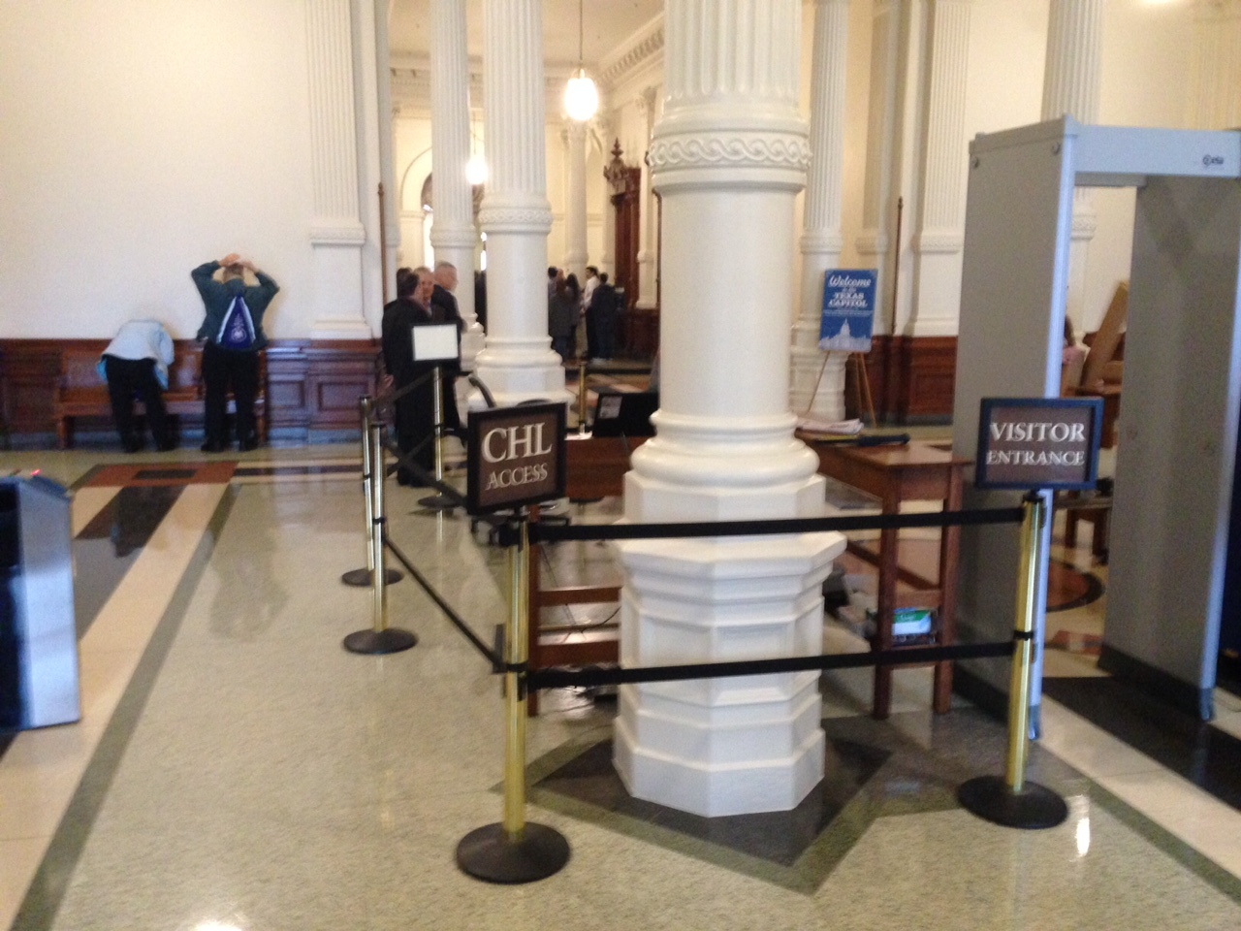

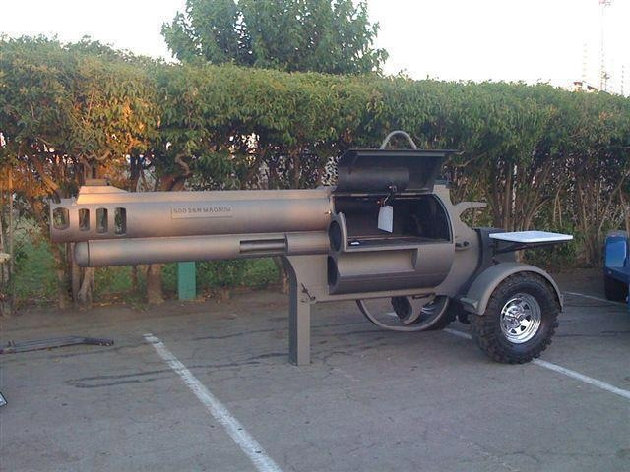
Texas is ‘Different’

Slide 23
Readmission Avoidance
At-Risk for readmission
  Referred by cardiac case managers
  Routine home visits
    In-home education!
    Overall assessment, vital signs, weights, ‘environment’ check, baseline 12L ECG, diet compliance, med compliance
    Feedback to primary care physician (PCP)
  Non-emergency access number for episodic care
  Decompensating?
    Refer to PCP early
    In-home diuresis

Slide 24
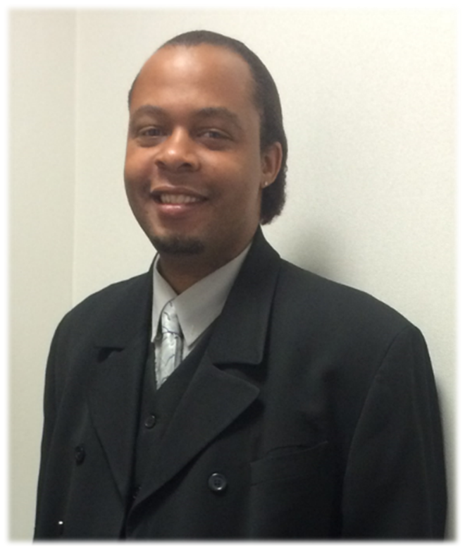
The Real Benefits:
“Before I started this program I was sick every day; I was going to the emergency room nearly every day.”
“I have learned more in the last three months from John and you than I have ever learned from the doctors, the hospitals, or the emergency rooms.”
“Since this program, I have not had any pain medicines and have not been to the emergency room. I am keeping up with my doctor’s appointment and my MHMR appointments.”
Antoine Hall, MIH/CHP Patient
Enrolled 11/20 – 12/29/13
Used by special permission from Antoine Hall

Slide 25
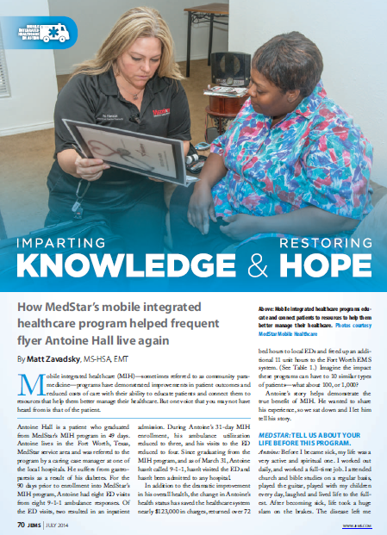
Antoine Analysis
 | Before | After | Change | Avg. Payment | Expenditure Savings
Ambulance Transports | 11 | 0 | -11 | $427 | ($4,697)
ED Visits | 12 | 0 | -12 | $774 | ($9,288)
Inpatient Admissions | 4 | 0 | -4 | $9,203 | ($36,812)
MIH Visits |  |  |  |  | 22
MIH Visit Expenditure per Contact |  |  |  |  | $75
MIH System Costs |  |  |  |  | $1,650
Healthcare System Savings |  |  |  |  | ($49,147)

Slide 26
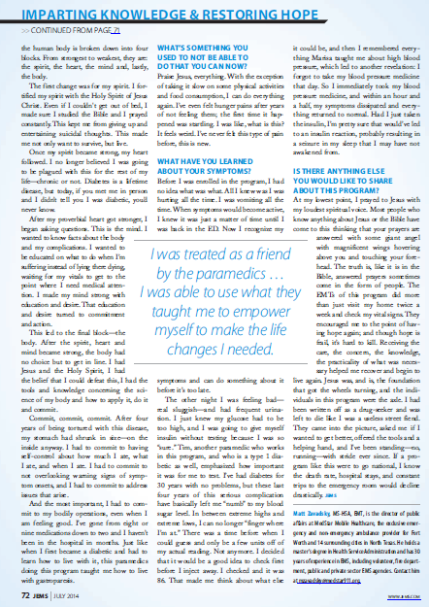

Slide 27

1115 Waiver
Partnership with John Peter Smith Health Network to expand:
  Readmission Prevention
  9-1-1 Nurse Triage
  High Utilizer Group
  Obs Admit Avoidance

Slide 28
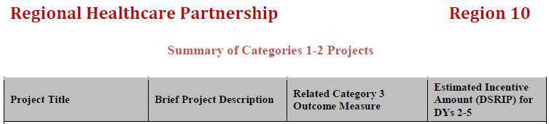
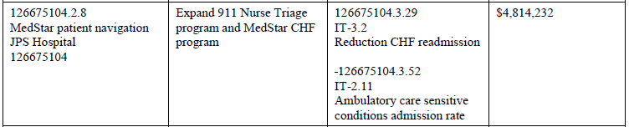
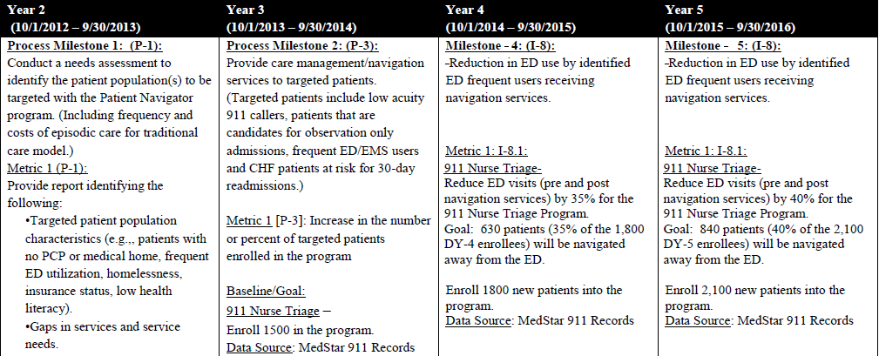

Slide 29
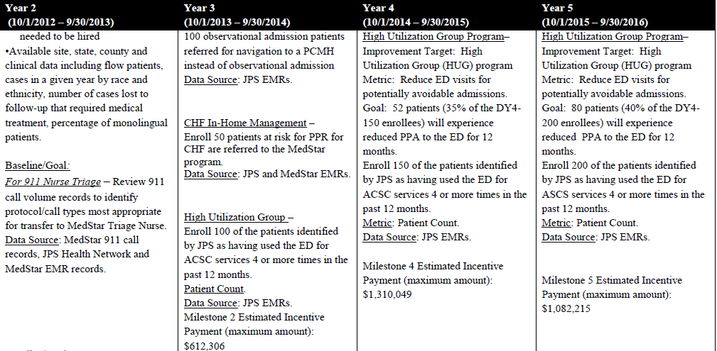

Slide 30
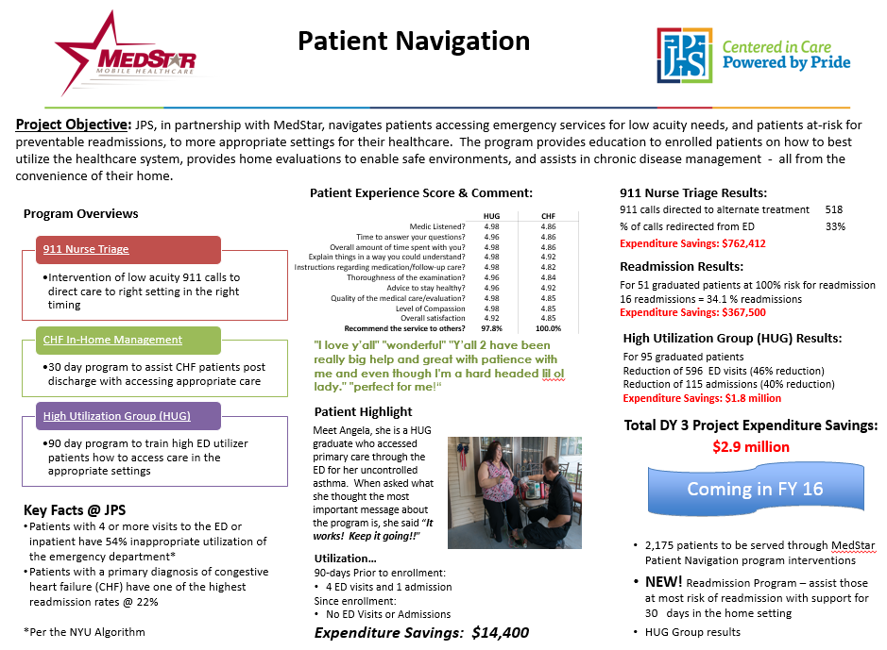
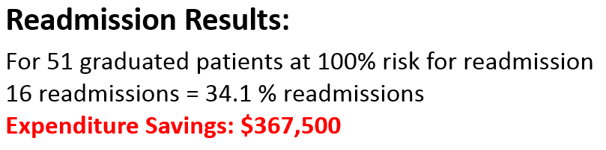

Slide 31
Readmit Program Analysis | June 2012 - June 2015 | JPS & THR Combined
Patient Enrollments (1, 3) | 119
 | 30 Day ED Visits | 30 Day Admissions
Count | 43 | 33
Rate | 36.1% | 27.7%
Rate Reduction (2) | 63.9% | 72.3%
Expenditure per Admission (4) |  | $ 10,500
Admissions Avoided |  | 86
Expenditure Savings |  | $ (903,000)
Admission Savings Per Patient |  | $ (7,588)
Notes:
1. Patient enrollment criteria requires a prior 30-day readmission and the
referral source expects the patient to have a 30-day readmission
2. Compared to the anticipated 100% readmission rate
3. Enrollment Period at least 30 days and less than 90 days
4. http://www.hcup-us.ahrq.gov/reports/projections/2013-01.pdf

Slide 32
Patient Self-Assessment of Health Status (1)
As of: | 6/30/2015
 | High Utilizer Group |  |  | Readmission Avoidance
 | Enrollment | Graduation | Change | Enrollment | Graduation |  | Change
Sample Size | 55 |  |  | 41
Mobility (2) | 2.33 | 2.55 | 9.4% | 2.37 | 2.41 |  | 1.7%
Self-Care (2) | 2.65 | 2.82 | 6.4% | 2.54 | 2.76 |  | 8.7%
Perform Usual Activities (2) | 2.24 | 2.58 | 15.2% | 2.27 | 2.51 |  | 10.6%
Pain and Discomfort (2) | 1.98 | 2.52 | 27.3% | 2.44 | 2.68 |  | 9.8%
Axiety/Depression (2) | 2.11 | 2.51 | 19.0% | 2.32 | 2.63 |  | 13.4%
Overall Health Status (3) | 5.18 | 6.85 | 32.2% | 4.88 | 6.78 |  | 38.9%
Notes:
1. Average scores of pre and post enrollment data from EuroQol EQ-5D-3L Assessment Questionaire
2. Score 1 - 3 with 3 most favorable
3. Score 1 - 10 with 10 most favorable

Slide 33
Mobile Healthcare Programs
Patient Experience Summary
Through June 30, 2015
 | Program
 | HUG | CHF | Overall Avg
Medic Listened? | 4.98 | 4.86 | 4.92
Time to answer your questions? | 4.96 | 4.86 | 4.91
Overall amount of time spent with you? | 4.98 | 4.86 | 4.92
Explain things in a way you could understand? | 4.98 | 4.92 | 4.95
Instructions regarding medication/follow-up care? | 4.98 | 4.82 | 4.90
Thoroughness of the examination? | 4.96 | 4.84 | 4.90
Advice to stay healthy? | 4.96 | 4.92 | 4.94
Quality of the medical care/evaluation? | 4.98 | 4.85 | 4.92
Level of Compassion | 4.98 | 4.85 | 4.92
Overall satisfaction | 4.92 | 4.85 | 4.89
Recommend the service to others? | 97.8% | 100.0% | 98.9%
Select Comments:
​Client states ''You care more about my health than I do."
"​Keep the same compassionate, excellent people you have working for you now and your service will continue to be great! Everything was perfect, a 10!"
​"yall have been off the charts helpful" "no complaints" "glad the hospital got it going for me"
​"Thank you very much! We couldnt have done this without you!"
"The medics spent lots of time with me and provided very useful information. I really loved the program. They were very friendly and did an awesome job."
​"I love y'all, wonderful, Y'all 2 have been really big help and great with patience with me even
though I'm a hard headed lil ol lady."

Slide 34
Home Health Issues
Instantly penalized for readmissions
  No more hospital referrals
  CMS Penalties for home health coming
High cost of night/weekend demand services
Don’t know when their patients call 911
  Consult to < admission

Slide 35
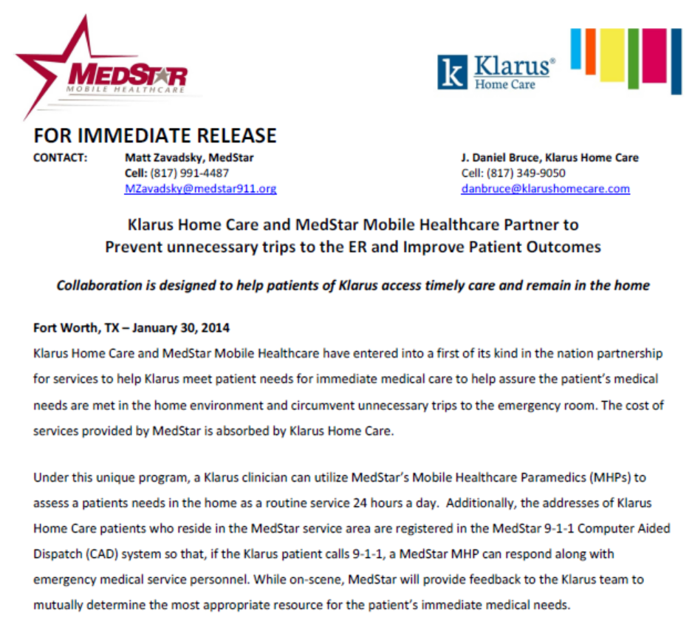
Home Health Partnership

Slide 36
Home Health
Care Coordination Examples
Client: XXXX, Oscar A – 19XX-12-18 Program: Home Health
Status: Active Referring Source: Klarus
Visit Date: 6/15/2015 Visit Type: Home Visit
Visit Acuity: Unscheduled Visit Visit Outcome: AMA
Transport Resource: N/A Response Number: 150615012
Note By: Tim Gattis

Slide 37
Note:
AOSTF 28 yo male sitting on couch. He states that he is SOB, his abdomen is distended and his legs are swollen all of this since 2000 this evening. He also reports his pump was alarming starting at 2100 and he shut it off.
Pt. requires Milrinone continuous infusion and the pump was reading a high pressure alarm. Pt. also reports a cough this evening. In reviewing his HX he has CHF with an EF of 20-25% and CKD. He reports he feels like he always does when he gets fluid overloaded. Pt. also reports a 4 lb. weight gain in the last 24 hrs. Upon exam noted pt. in mild -moderate resp. distress with SPO2 in the 80's off his O2. In reviewing some old notes he does not like to wear his O2. Pt. is A&OX4, PPTE, MAE. Pt. is mildly tachycardic, BS clear upper and crackles in bases. ST on 12-lead W/O elevation.
Abdomen appears distended though I have never seen this pt. in the past. Pt. has 3+ edema in lower ext. PICC line port being used for Milrinone infusion was occluded. PICC was flushed and infusion resumed. Chem 8 was obtained. NA 133, K+ 3.7, Cl 97, CA 1.19, Tco2 36, Glucose 143, BUN 38, Cre 1.3, Hct 40, Hgb 13.6A Gap 5. Pt. was given Lasix 80mg SIVP and advised to double his morning potassium dose. The importance of wearing his O2 was again stressed. I discussed the plan with pt. to ensure he felt capable of staying at home and that was his preference.
Pt. stated he had a urinal and was advised to use it and write down all of his output between now and when he sees the nurse. He was advised to call back for any issues or worsening of condition. I also spoke with Sean at Klarus and he is good with plan. Klarus will follow up tomorrow with client. Pt. declined transport and AMA was signed. ​

Slide 38
Client: XXXX, Clara L - 1934-03-06 Program: Home Health - 911
Visit Date: 8/21/2015 Visit Type: Home Visit
Visit Acuity: 911 Call Transport Resource: N/A
Response Number: 150821007 Note By: Ronald Moren
Family called 911 and stated pts BGL was 29. On EMS arrival, family had managed to give pt a few mouthfuls of honey and BGL was 32. Pt found lying in bed pt is alert to painful stimuli only. Pt is atraumatic. BBS are clear, =, bilateral with good chest rise and fall. Abd is soft and non-tender with no masses noted. Pt has a PICC line in right arm that she receives daily antibiotics from family through. PICC line was accessed and approx 7 ml fluid withdrawn. IV D-10 was started and 250 ml was infused. Pt became A&OX4 and BGL increased to 188. Pts daughter cooked her some eggs and gave her an ensure to drink.
Pt states she feels much better and does not want to go to the ER at this time. It was explained to the patient and her family that a large decrease in blood sugar, while may be expected, should still be evaluated by a physician. Pt and family still did not want to go to the ER. Pt and family were educated on possible problems with low BGL including falls, syncope, AMS, & seizures. Family was instructed to monitor blood glucose levels and to contact KLARUS and/or her PCP in the morning. Family was also instructed to call 911 again if pts condition changes.
KLARUS was contacted and message left, RN (Diane) called back and confirmed message received and advised she would have somebody go out and see patient in the morning.

Slide 39
Client: XXXXX, Joycia Y – 19XX-XX-XX Program: Home Health - 911
Referring Source: Klarus Visit Date: 4/11/2015
Visit Type: Home Visit
Visit Acuity: 911 Call
AOSTF pt. lying on couch in NAD. Crew reports pt. has been having CP since last night and is mid sternal and radiates to her back, rates at 9/10. Her pain is worsened by movement and breathing.
Her V/S are reported to be stable and she is reported to be a little anxious. In speaking with the pt. she agrees with the crews report of the situation. She also reports she has had a 10lb weight gain since yesterday according to her Cardiocom unit.
She has had this in the past and this is the same pain she usually has. She believes her NTG will relieve it but she was afraid to take as Klarus usually walks her through it. She also has an anxiety history and has not taken her Xanax or other morning meds yet. Pt. denies any N/V or diaphoresis.

Slide 40
She also feels like her hands and feet are swollen as they feel tight. She denies additional complaint. Upon exam noted pt. in NAD. Pt. is A&OX4, PPTE, MAE. VSS. BSCB, non labored. SR on 12-lead w/o acute changes. No edema is noted to hands and very mild edema noted to top of her feet once socks removed. I spoke with Diana at Klarus regarding this pt. I reported her complaints. I did advise her about the weight gain. She felt pt. should take her NTG. She also reports pt. has been to the hospital for this in the past and was ruled Anxiety those times.
Pt. reported dramatic improvement in the discomfort after the NTG. Pt. was advised we could not R/O cardiac involvement without blood work but pointed out what we found on exam. Pt. opted to take her morning meds and stay at home.
As we were getting ready to leave Diana called back and reported her weight had in fact increased by 10 lbs. over the last 24 hours and would like her to be diuresed. I relayed this to the pt. and she agrees to plan.
A Chem 8 was obtained and her K+, Hct and Hgb was noted to be low.

Slide 41
I spoke with Dr. Davis regarding the Potassium dosing since she was a little low and he advises to increase her Potassium from 40 mEq Bid to 40mEq Tid today only.
IV was initiated and Lasix 100mg IV was given SIVP. Pt. was advised to monitor and record her urine output using the hat she was provided and we would see her at 1400 for a F/U. If anything changes to call Klarus or us back. Pt. remains pain free upon departure.
I again spoke with Diana and advised of the treatment and that she would need a visit from them within 24 hrs. by protocol and she was going to get that set up. Visit complete.

Slide 42
Utilization Outcome Summary | As of: | Jul-15
Home Health Partnership
 | # | %
Enrollments by Home Health Agency | 754 | 100.0%
9-1-1 calls by Enrolled Patients | 455 | 60.3%
9-1-1 Calls by Enrolled Patients with a CCP on-scene | 200 | 44.0%
ED Transports when CCP on Scene | 74 | 37.0%
Home Visits Requested by Agency | 158 | 21.0%
ED Transports from home visits requested by Agency | 6 | 3.8%

Slide 43


Slide 44
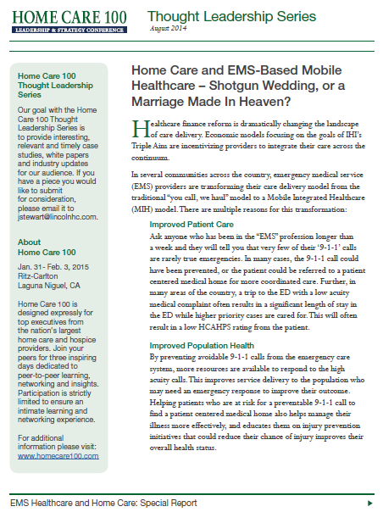
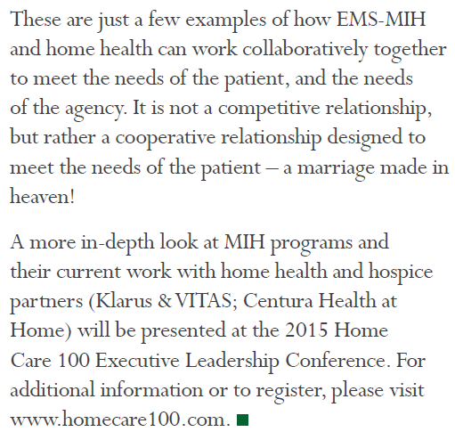

Slide 45
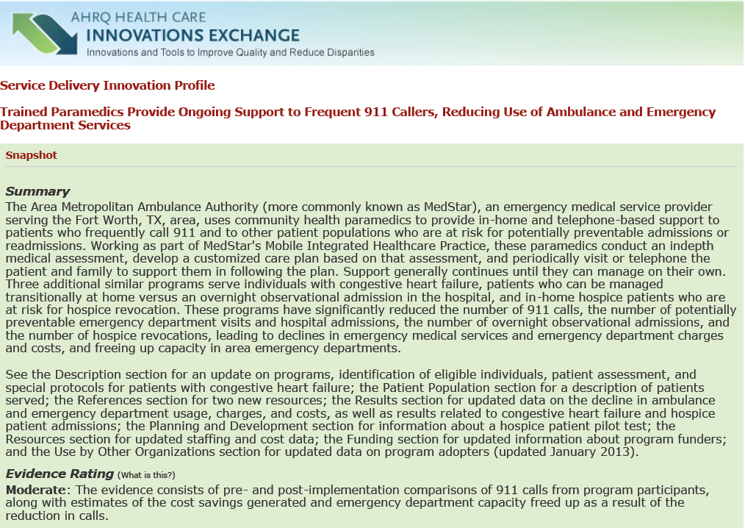

Slide 46
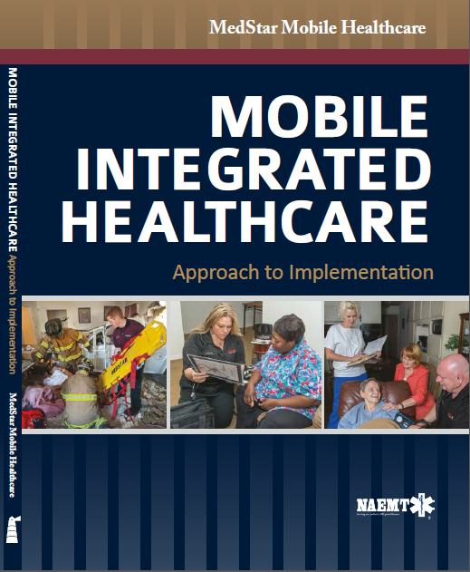

“Mobile Integrated Healthcare is an innovative and patient-centered approach to meeting the needs of patients and their families. The model does require you to “flip” your thinking about almost everything – from roles for health care providers, to what an EMT or paramedic might do to care for a patient in their home, to how we will get paid for care in the future.
The authors teach us how to flip our thinking about using home visits to assess safety and health. They encourage us to segment patients and design new ways to relate to and support these patients. And they urge us to use all of the assets in a community to get to better care. This is our shared professional challenge, and it will take new models, new relationships, and new skills.”
Maureen Bisognano
President and CEO
Institute for Healthcare Improvement

Slide 47


Slide 48
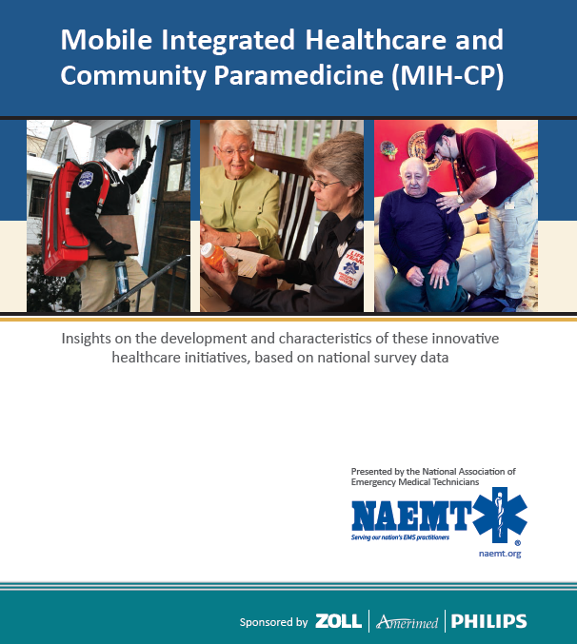
2009 = 4 Programs
2014 = 160 Programs

Slide 49
Paramedics Aren't Just for Emergencies
Home visits for lab tests, IV medications and hospital follow-up
By Laura Landro
Aug. 17, 2015
Paramedics, who race to emergencies and transport victims to the nearest ER, are taking on a new role: keeping patients out of the hospital.
In this new role, paramedics augment existing programs like visiting nurse services and home care. They also treat patients who don’t meet home-nursing criteria or don’t want someone in their home all the time but still have complex needs, says David Schoenwetter, an emergency physician and head of the mobile health paramedic pilot program at Geisinger Wyoming Valley Medical Center in Wilkes-Barre, Pa., part of Danville, Pa.-based Geisinger Health System.
The programs aim to reduce the high costs of emergency room visits and inpatient hospital stays. Hospitals are facing financial penalties from Medicare and other payers when patients are readmitted to the hospital within 30 days of being discharged.
days among 704 patients who had a home visit from a paramedic, Geisinger calculates. In tFrom March 2014 to June 2015, the Geisinger mobile health team prevented 42 hospitalizations, 33 emergency department visits and 168 inpatient he case of heart-failure patients, hospital admissions and emergency-room visits were reduced by 50%, and the rate of hospital readmissions within 30 days fell by 15%. Patient satisfaction scores for the program were 100%.
http://www.wsj.com/articles/paramedics-aren-t-just-for-emergencies-1439832074

Slide 50

Change From the Inside Out –
Health Care Leaders Taking the Helm
Donald M. Berwick, MD, MPP1; Derek Feeley, DBA1; Saranya Loehrer, MD, MPH1
1Institute for Healthcare Improvement, Cambridge, Massachusetts
JAMA. March 26, 2015.
doi:10.1001/jama.2015.2830
Even as politicians and pundits continue to debate the merits of the Affordable Care Act (ACA), it is time to look beyond it to the next phase of US health care reform.
innovations in delivery mature at a far faster pace than laws and regulations evolve, even in far less contentious political times than today’s. For example, productive new health care roles, such as community paramedics, community health workers, and resilience counselors, emerge at a rate that legal requirements and reimbursement policies simply do not match.
http://jama.jamanetwork.com/article.aspx?articleid=2210910

Slide 51
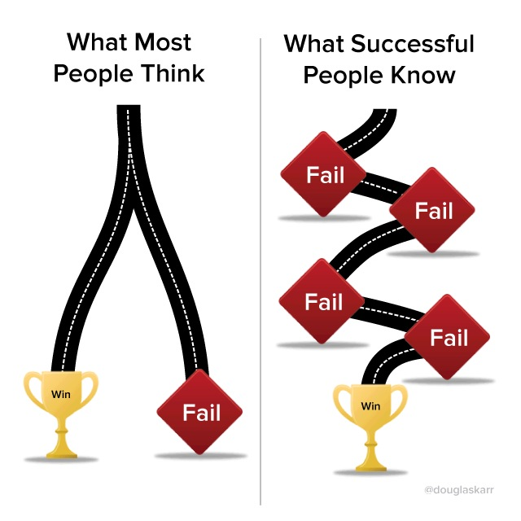

Slide 52


