Slide 1
Improving Marketshare
by Improving Value
Moore Foundation
April 22, 2014
\
Arnold Milstein MD
Kimberly Brayton MD, JD
Stanford Clinical Excellence Research Center

Slide 2
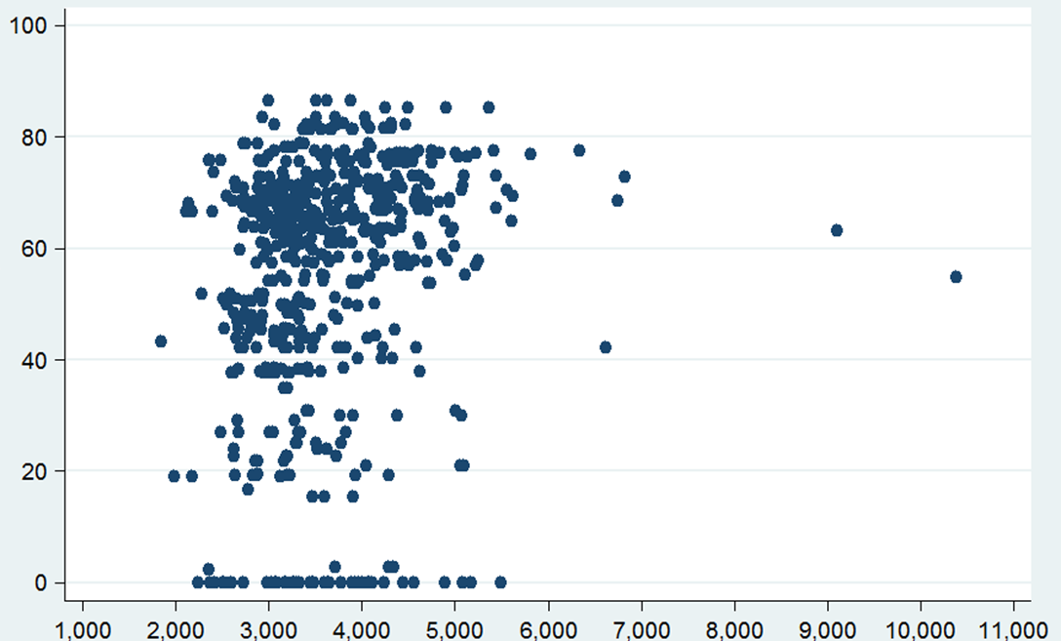
Gauging the Static Improvement Opportunity
Performance of 200+ California Physician Groups Currently Accountable for Value
Current value frontier
Quality Composite Score
Risk-Adjusted Total Cost of Care ($ PMPY)
Source: IHA 2012

Slide 3
Features of Today’s Positive Value Outliers
Intensifying care for the most unstable
patient quintile
Systematizing processes that count
Curbing valueless practice pattern variation

Slide 4
Primary Care Population Management “Idol” Sites

Slide 5
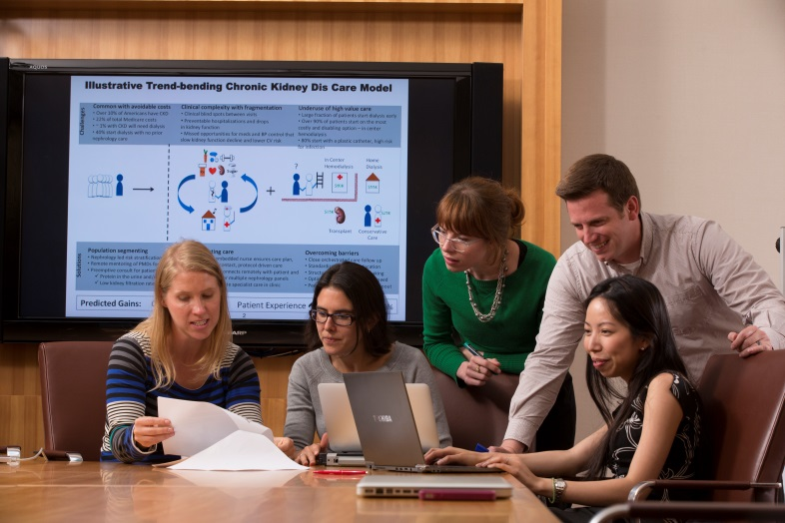
Pushing Beyond Today’s Value Frontier
Job 1: Prevent strategically and produce efficiently
Young designers plus seasoned mentors
Composites formed from global value frontier, emerging science/tech and “disgusters”
Care Innovation Design Team

Slide 6
Illustrative Composite Care Innovation for Stroke Prevention and Treatment
Avoid vascular risk by economically maximizing protective Rx use
Convert hospital care of transient ischemic attack and mild stroke to care in safe alternative settings for most patients
Transform tPA use and post-hospital care
~11% estimated net reduction in direct healthcare spending on stroke and heart attack (and large reduction in strokes & disabling strokes)

Slide 7
Transforming Ambulatory Surgical Care: Triple-R Model
Inappropriate Use of Surgery
Patient expectations ineffectively managed Primary providers lack time, resources to adjudicate surgical indications Rampant overuse and underuse (~30%)
Inappropriate Location
~57 million outpatient surgeries/year 55% performed in hospitals, a ~2-3x higher cost setting Marked price variation for procedures
Ineffective Care Processes
Difficult and inefficient patient transitions: Within parts of system: Lack of standardized procedures leading to delays Between parts of the system: Lack of communication leading to redundancy
Challenges
Reduce
Patients. Elicit preferences, establish expectations, employ decision aids Providers. Empower with guideline-based clinical decision support tools System. Enable case coaching from independent expert surgeon Savings: 5-10%
Reset
Patients. Price & outcome transparency System. Transition majority of 23-hour obs procedures to reconceptualized ASCs Multi-specialty High volume Expanded facility hours (18/7) Savings: 3%
Replicate
System. Standardized care pathways Standardized equipment/supplies Real-time internal cost transparency Patients. Enable end-to-end, closed-loop care Patient dashboard Case manager Pre-surgical tune-up Savings: 2-3%
Solutions
Combined Benefits:
↑ Experience
↑ Clinical Outcome
↓ Spending $20-30 Billion

Slide 8
Foreseeing the Dynamic Improvement Opportunity (Predicting What a Learning Healthcare System is Likely to Learn)
Content: multi-axial patient assessment
and care plan
Culture: caring, parsimony, reliability
Control: brain, brawn and bits

