Slide 1
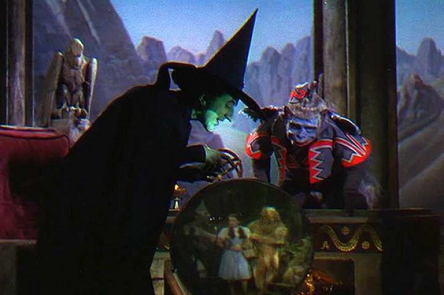
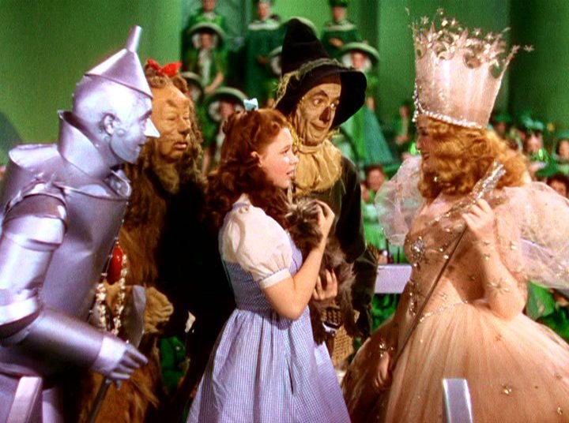
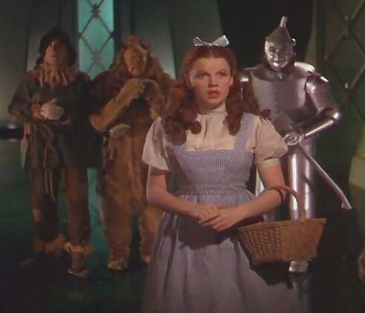
Principles of Engaging Leadership
Situation Monitoring
Mutual Support
Communication
Leadership
Notes:
Just Like in the Teamstepps model – 4 elements of an effective team. Engaging leadership uses the same basic principles
Situation Monitoring- Know who you are dealing with and their given situation. Healthy organization? Recent leadership turnover? Cohesive? Devisive? Do your best to ascertain before approach with an “ask”
Do your homeworks with the goal of Developing a Shared Mental Model with leadership
- understand their dynamics and find a way to get on the same page
- WIIFM – look at the situation from their perspective
Mutual Support – Help leadership understand that the ultimate goals are mutually beneficial – everyone wins
Make sure they know you will support them however necessary
WIIFM also applies here
Communication – Clear, Concise, Timely, and Brief Communication will serve you well when engaging organizational leadership
WIIFM again – getting the point?
Leadership - To engage a leader, present your information as a leader – Leaders respect each other

Slide 2
Getting the Whole Team Headed Towards the Goal
Board
Senior Leadership
Physicians
Department Leadership
Staff
Patients
Mutual Accountability
Rapid Cycle Improvement
Lasting Culture Change
Notes:
Who is the Team you are wanting to engage?
What do we need them to understand?
First 6 bullets comprise the team from a hospital’s standpoint.
The first Four are generally considered the leadership, but staff and patient’s can be just as tricky to engage if not more so.
The bottom 3 bullets are the global goals of the team, regardless of the specific collaborative or project

Slide 3
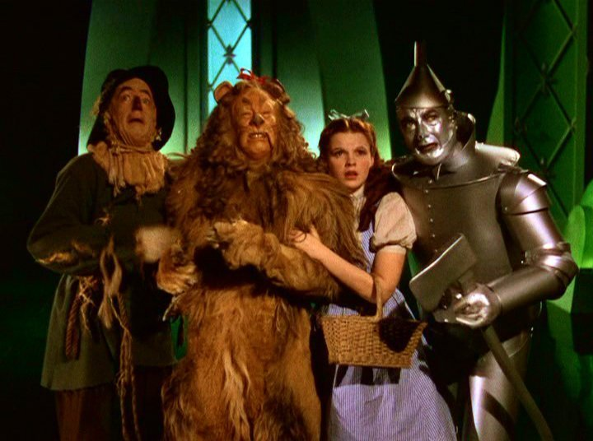
What are you Asking From Leadership?
Commitment
Collaboration
Communication
Celebration
Notes:
The whole process in an easy to understand format (the Baptist preacher model)
We want their commitment to the collaborative and it’s goals – We want “Buy in”
We want them to collaborate and work together with you and everyone on the team – moving forward together with a shared mental model
We need consummate, frequent communication that is Clear, Concise, Brief, and Timely
We need to remind them that celebrating goals – primary goals, ultimate goals, and small, incremental goals – is incredibly

